Slide 1




Slide 2



Slide 3

#1

Slide 4

#2

Slide 5
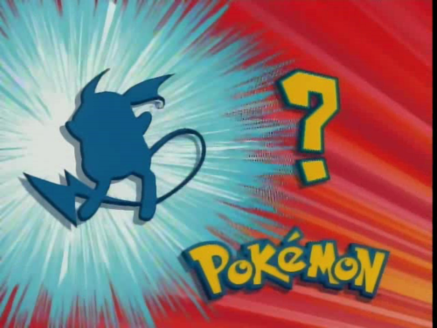
#3

Slide 6
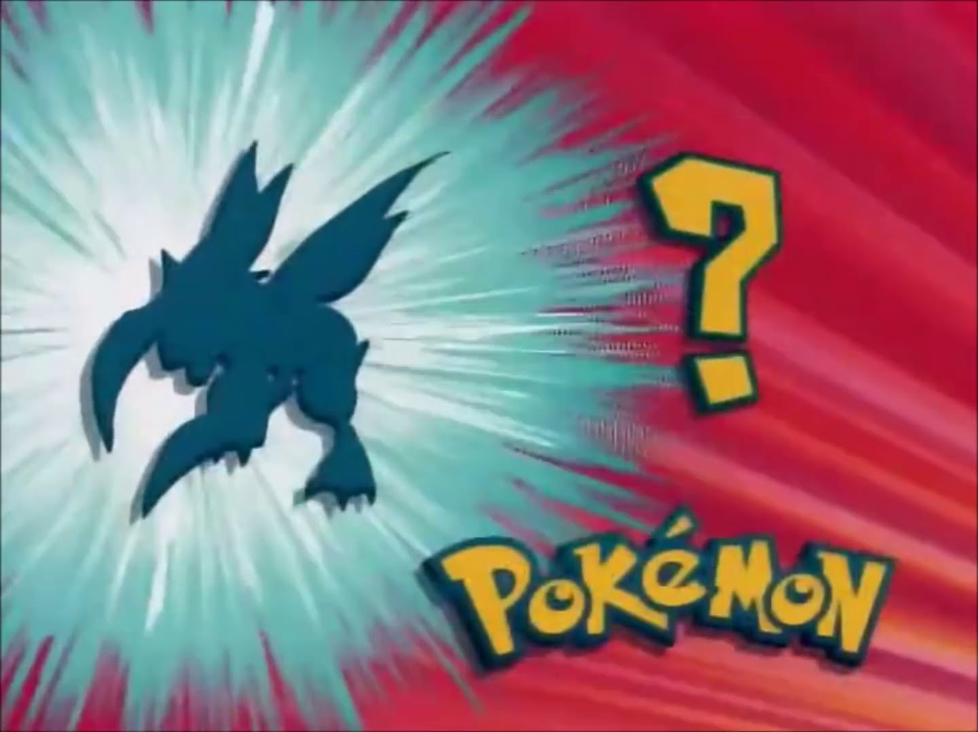
#4

Slide 7
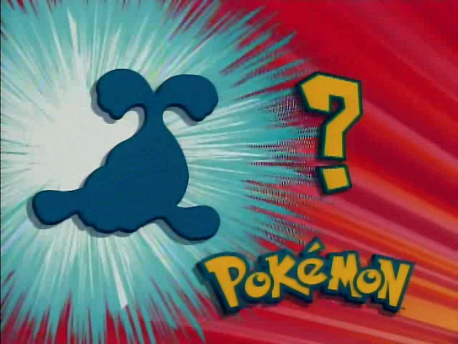
#5

Slide 8

#6

Slide 9
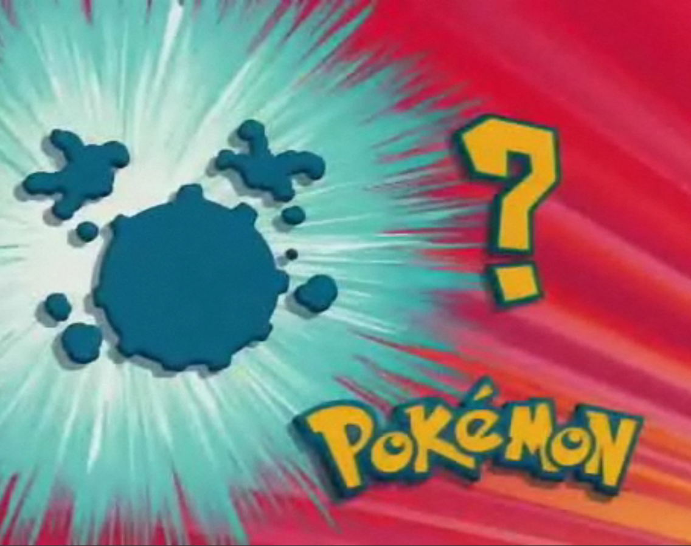
#7

Slide 10

#8

Slide 11
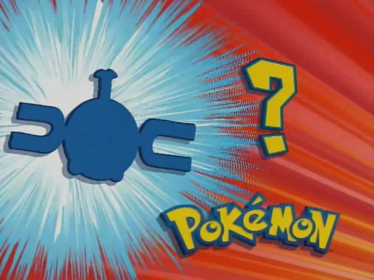
#9

Slide 12

#10

Slide 13

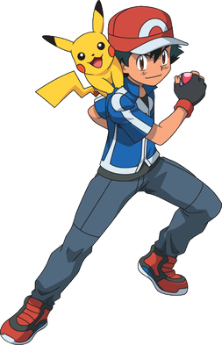
Answers!

Slide 14
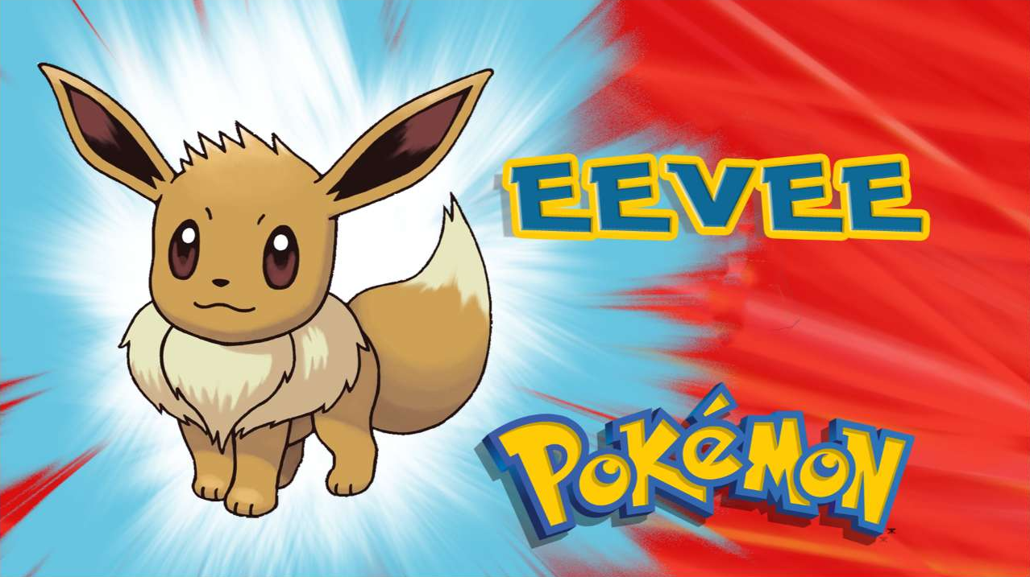
#1

Slide 15

#2

Slide 16

#3

Slide 17
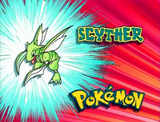
#4

Slide 18
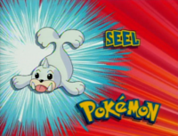
#5

Slide 19
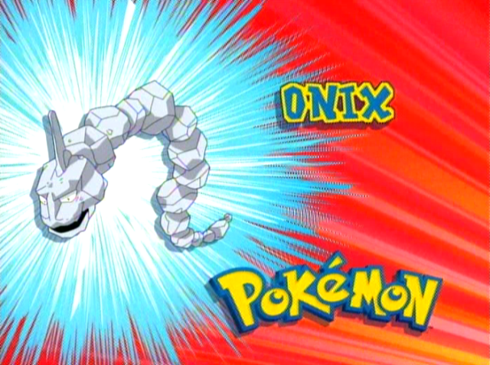
#6

Slide 20
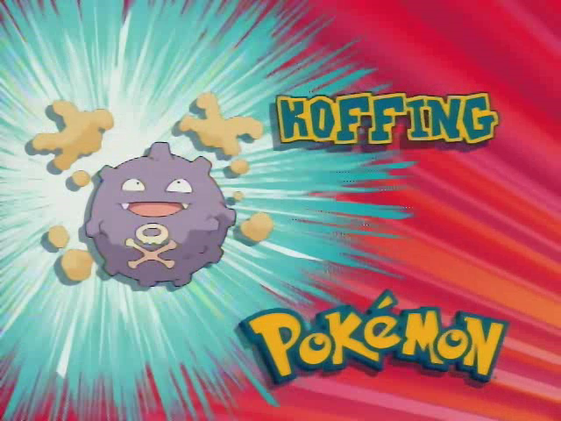
#7

Slide 21
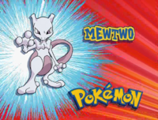
#8

Slide 22
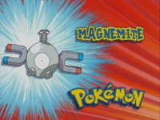
#9

Slide 23
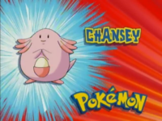
#10

Slide 24



Slide 25

#1
What is this character’s name?

Slide 26

#2
Name the 3 Starter Pokémon that Trainers can choose from when they begin.

Slide 27
#3
Which of the following is true:
Team Rocket once forced their Pokémon to learn how to sing as a money making scheme
Team Rocket once set up a beauty salon and gave Pokémon makeovers
Team Rocket’s favourite mode of transportation is teleportation

Slide 28

#4
What is this character’s name?

Slide 29
#5
Fill in the blanks from the Pokémon Theme Song:
I wanna be the very ___________
Like no one ever was
To catch them is my real __________
To train them is my ____________

Slide 30
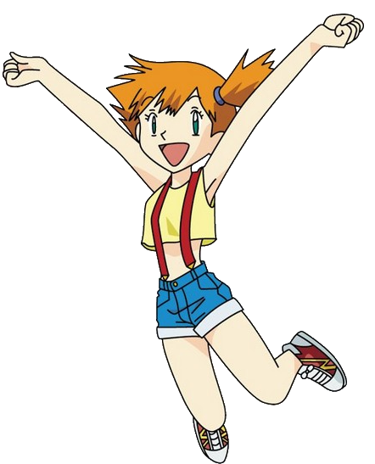
#6
What is this character’s name?

Slide 31

#7
Which Pokémon simulates the look of a Pokeball, but can self destruct if necessary?

Slide 32

#8
Name 3 types of Pokeballs, besides the original

Slide 33

#9
There are 18 types of Pokemon. Name 3 types.

Slide 34

#10
Name the 3 Teams from Pokemon GO

Slide 35
Answers!

Slide 36
#1
What is this character’s name?
Ash Ketchum

Slide 37
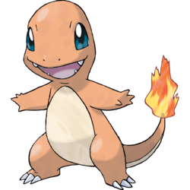
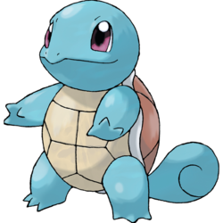
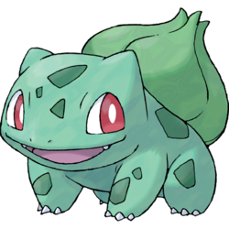
#2
Name the 3 Starter Pokémon that Trainers can choose from when they begin.
Bulbasaur
Charmander
Squirtle

Slide 38
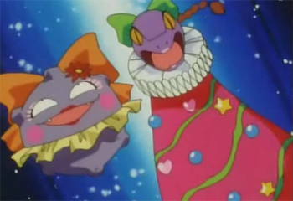
#3
b) Team Rocket once set up a beauty salon and gave Pokémon makeovers
Which of the following is true:
Team Rocket once forced their Pokémon to learn how to sing as a money making scheme
Team Rocket once set up a beauty salon and gave Pokémon makeovers
Team Rocket’s favourite mode of transportation is teleportation

Slide 39
#4
What is this character’s name?
Jessie

Slide 40
#5
Fill in the blanks from the Pokémon Theme Song:
I wanna be the very _______
Like no one ever was
To catch them is my real _____
To train them is my _______
best
test
cause

Slide 41
#6
What is this character’s name?
Misty

Slide 42

#7
Which Pokémon simulates the look of a Pokeball, but can self destruct if necessary?
Voltorb

Slide 43
#8
Cherish Ball
Dive Ball
Dusk Ball
Fast Ball
Friend Ball
Great Ball
Heal Ball
Heavy Ball
Level Ball
Love Ball
Lure Ball
Luxury Ball
Master Ball
Moon Ball
Nest Ball
Net Ball
Park Ball
Poké Ball
Premier Ball
Quick Ball
Repeat Ball
Safari Ball
Sport Ball
Timer Ball
Ultra Ball
Name 3 types of Pokeballs, besides the original

Slide 44
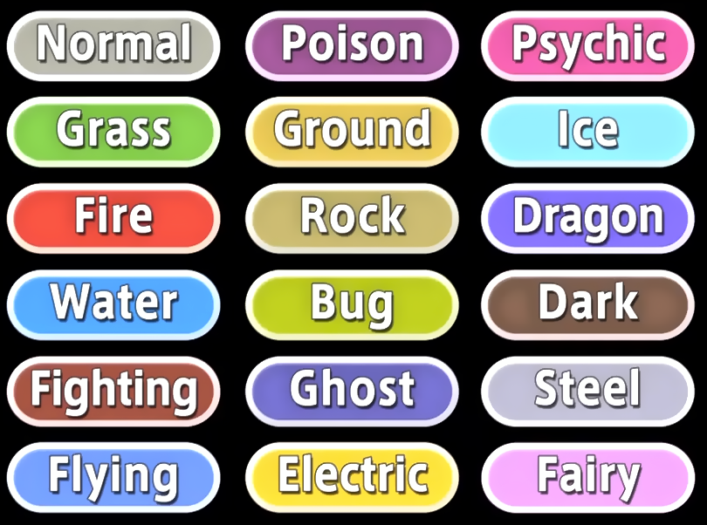
#9
There are 18 types of Pokemon. Name 3 types.

Slide 45
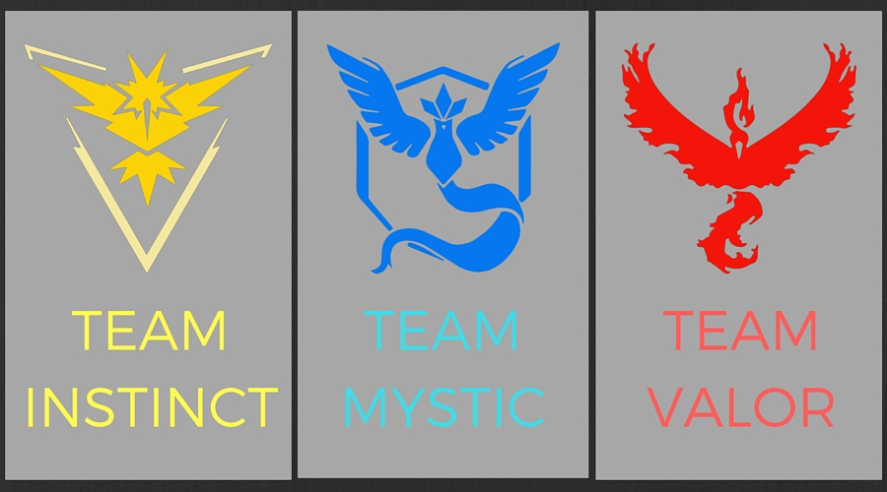
#10
Name the 3 Teams from Pokemon GO

Slide 46

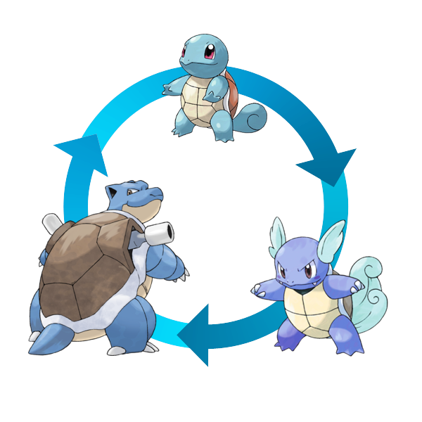

**All answers are for Generation 1 Pokemon only**

Slide 47
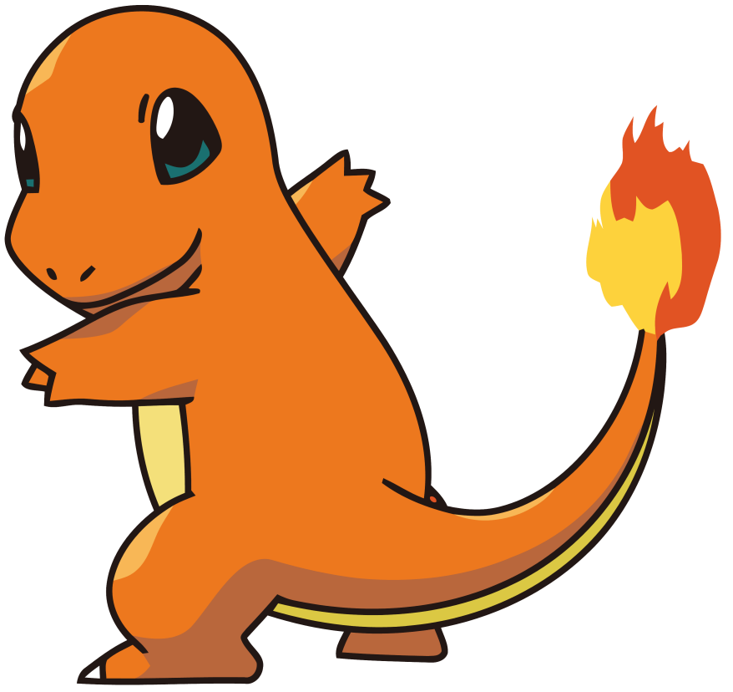
#1
Name the 3 forms of this Pokémon

Slide 48
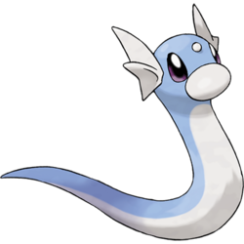
#2
What is Dratini’s final form?

Slide 49
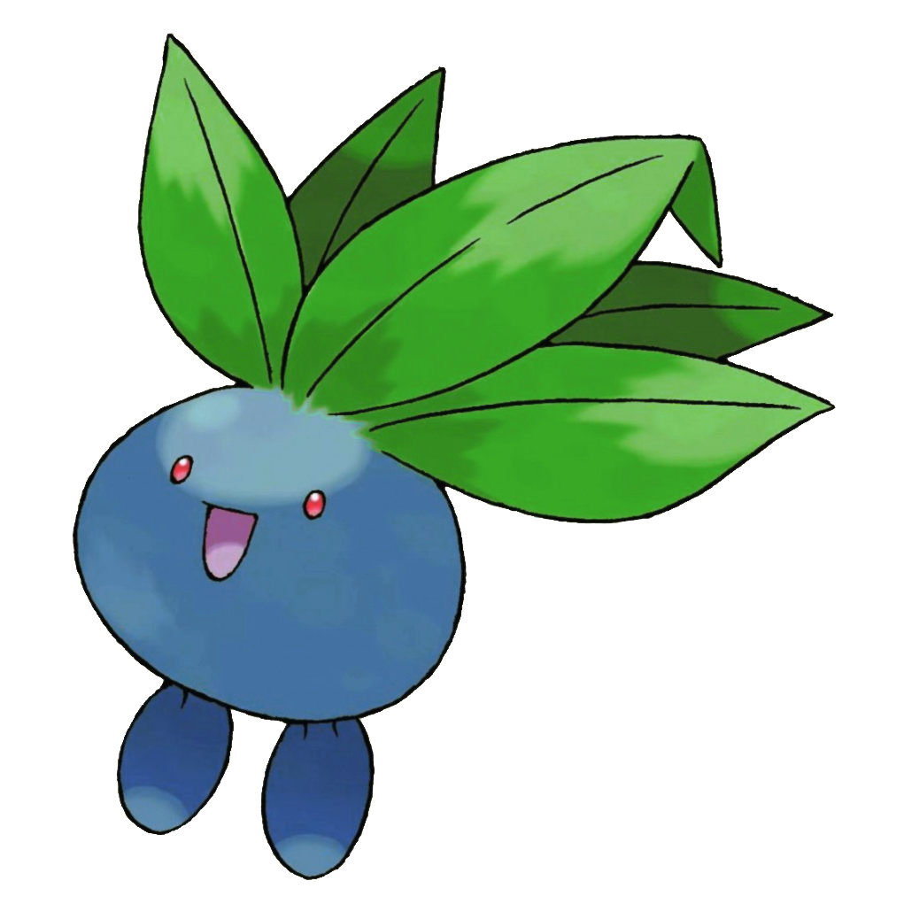
#3
Name the 3 forms of this Pokémon

Slide 50
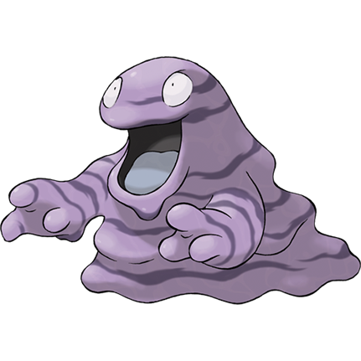
#4
Name the 2 forms of this Pokémon

Slide 51
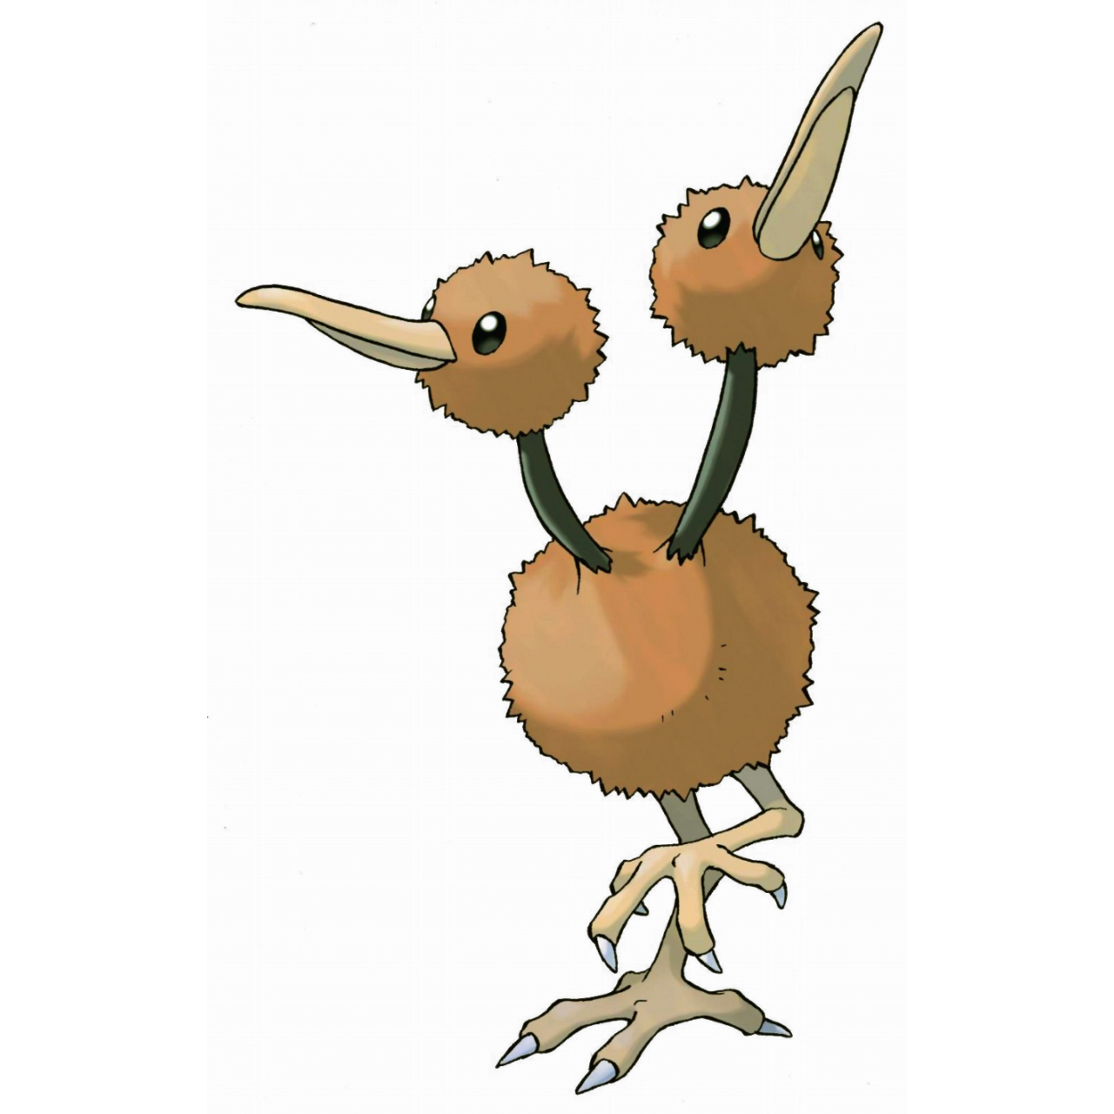
#5
Name the 2 forms of this Pokémon

Slide 52
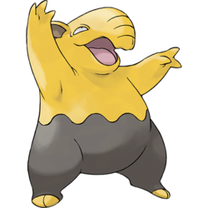
#6
What does a Drowzee evolve into?

Slide 53
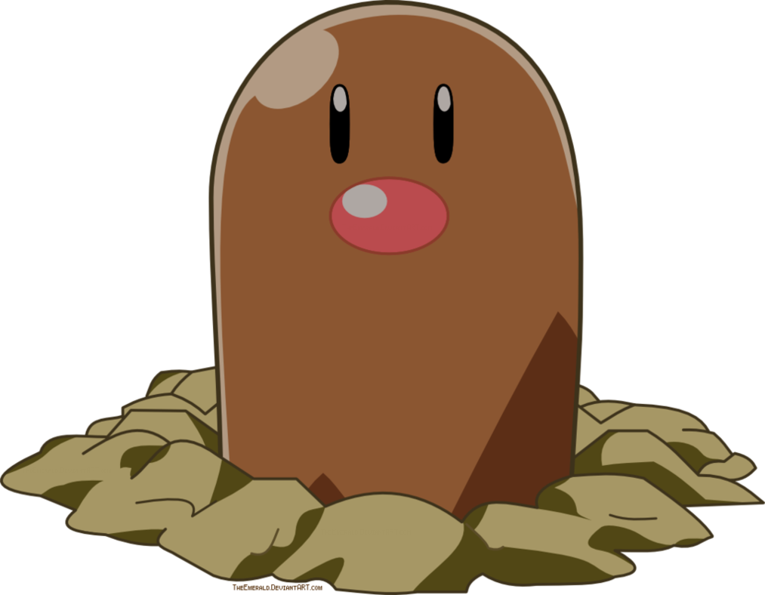
#7
What does a Diglett evolve into?

Slide 54
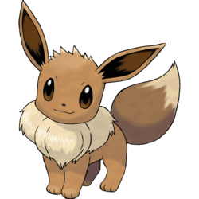
#8
Name the 3 Eevee evolutions

Slide 55
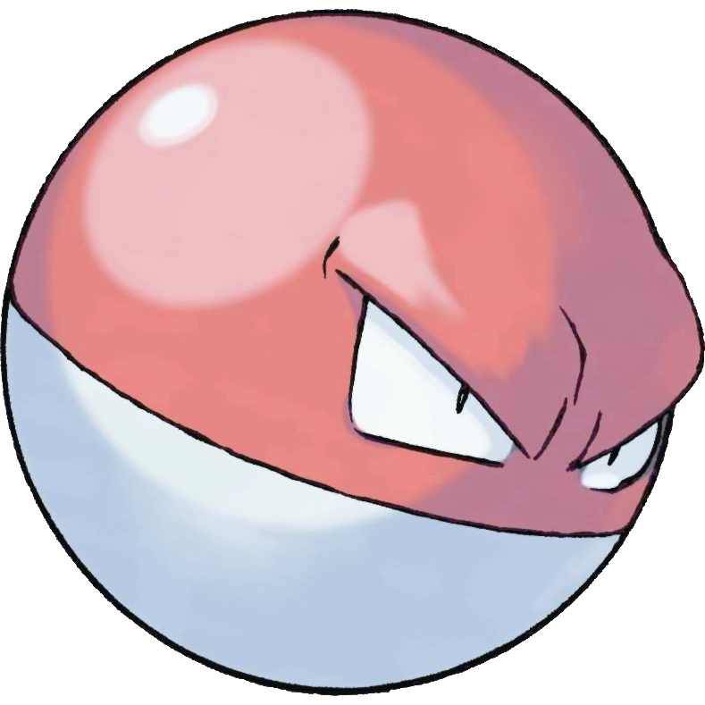
#9
Name the 2 forms of this Pokémon

Slide 56

#10
Name the 2 forms of this Pokémon

Slide 57
#11
Name 3 Pokémon that DON’T evolve

Slide 58
Answers!

Slide 59
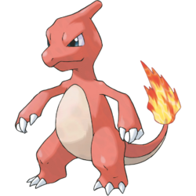
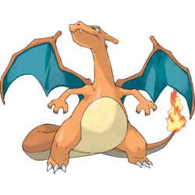
#1
Name the 3 forms of this Pokémon
Charmander
Charmeleon
Charizard

Slide 60
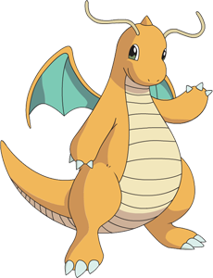
#2
What is Dratini’s final form?
Dragonite

Slide 61

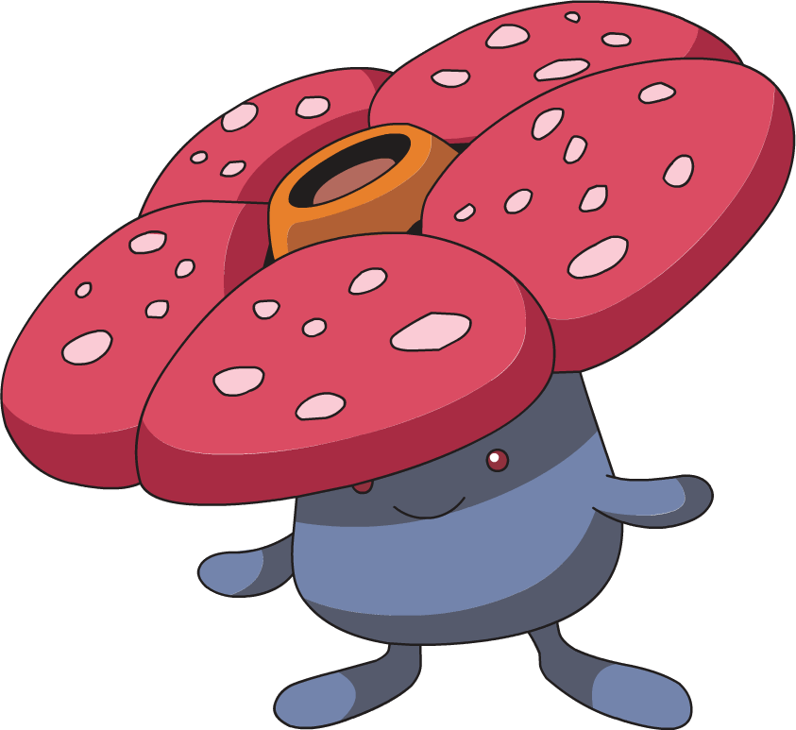
#3
Name the 3 forms of this Pokémon
Oddish
Gloom
Vileplume

Slide 62
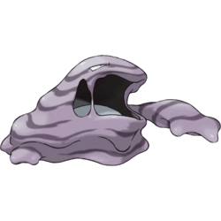
#4
Name the 2 forms of this Pokémon
Grimer Muk

Slide 63
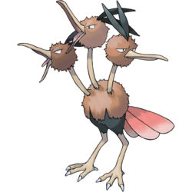
#5
Name the 2 forms of this Pokémon
Doduo
Dodrio

Slide 64

#6
What does a Drowzee evolve into?
Hypno

Slide 65
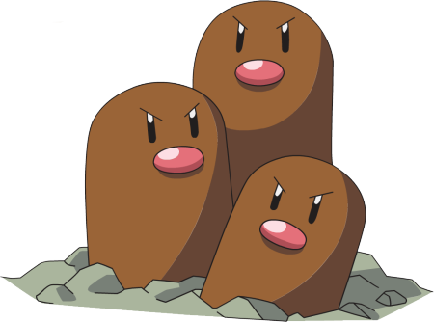
#7
What does a Diglett evolve into?
Dugtrio

Slide 66
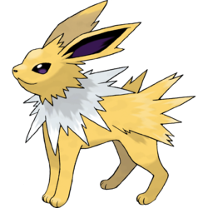
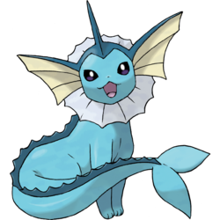
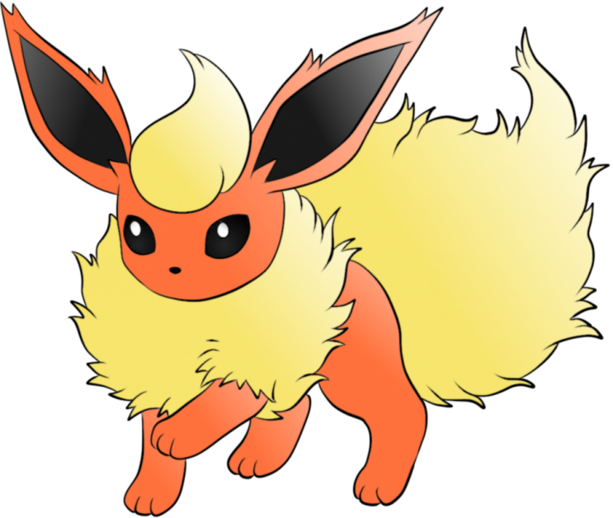
#8
Name the 3 Eevee evolutions
Vaporeon
Flareon
Jolteon

Slide 67
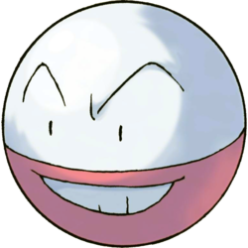
#9
Name the 2 forms of this Pokémon
Voltorb
Electrode

Slide 68
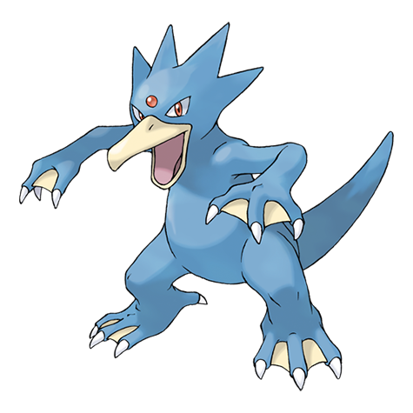
#10
Name the 2 forms of this Pokémon
Psyduck
Golduck

Slide 69
#11
Name 3 Pokémon that DON’T evolve
Aerodactyl
Articuno
Chansey
Ditto
Electrabuzz
Farfetch'd
Jynx
Kangaskhan
Lapras
Lickitung
Magmar
Mew
Mewtwo
Moltres
Mr. Mime
Onix
Pinsir
Scyther
Snorlax
Tangela
Tauros
Zapdos

Slide 70
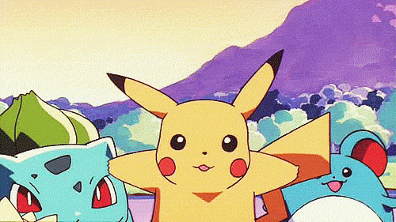
And the winner is…

